Slide 1
Lecture 4 seismic station

Slide 2
The main objective of seismic station
Recording and analysis of earthquakes
Issuing a monthly earthquake bulletin
Research studies, seismic hazard assessment, and microearthquakes studies
Preparing a technical report (site selection) for the vital and important structures in Iraq such as dams, thermoelectical stations, bridge….
introducing an earthquake data to The university for the research programs
Research studies and Microzonation seismic hazard
assessment. and Micro earthquakes studies.

Slide 3
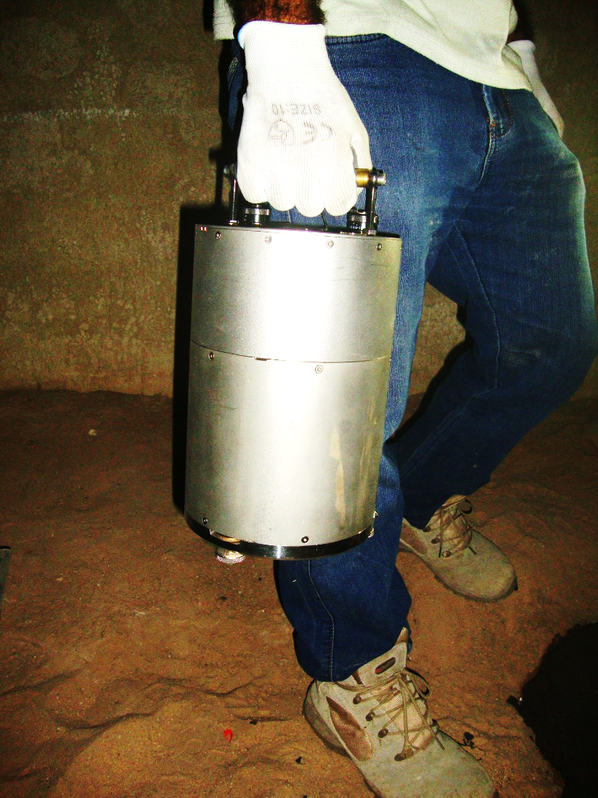
Seismic Instruments
Seismic Stations
Seismometer (Seismograph)
Digitizer
GPS
Computer
Power
Wires

Slide 4
Seismometer
It is an instrument that used by seismologist to measuring seismic waves that produced by
earthquakes, there is three types of seismometer which are: 1-High Frequency,
2- Strong Motion,
3- Broadband.
Broadband type of seismometer- which record long range of waves that have a frequency
(0.01-100) Hz, that means it record all types of earthquake weak and strong, far and near a

Slide 5
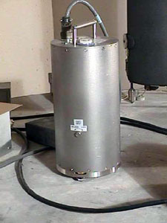
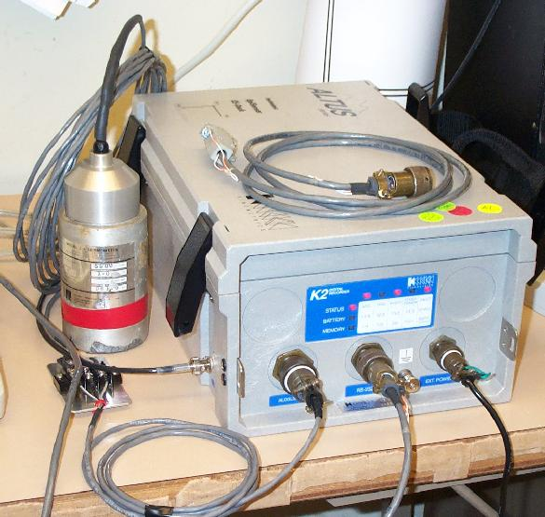
Seismographs
Modern digital broadband seismographs are capable of recording almost the whole seismological spectrum (50 Hz – 300 s).
Their resolution of 24 bits (high dynamic range) allows for precise recording of small quakes, as well as unsaturated registration of the largest ones.

Slide 6
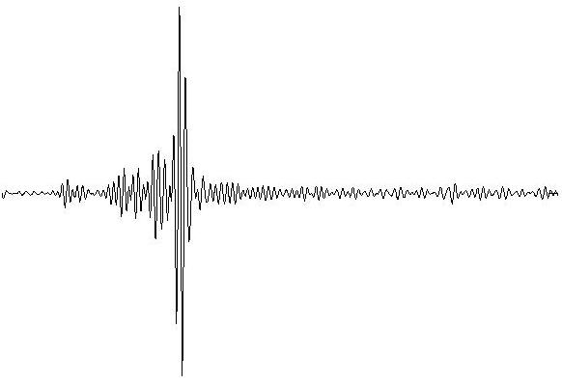
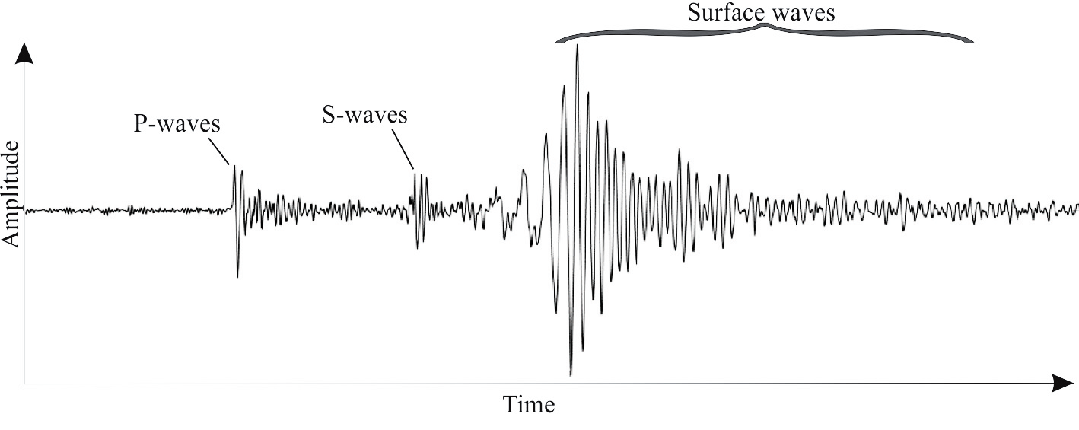
The Seismogram
is a graph output by a seismograph.it is record of the ground motion at a measuring station as a function of time.
Seismogram typically record motions in the three components axes x,y,z

Slide 7
Source Parameters
Date (YYYY/MM/DD) ➔ UTC time
Time (HH:MM:SS.SSS)
Latitude
Longitude
Depth (Km)
Magnitude (ML, MN, MB, MW.. Etc.)

Slide 8
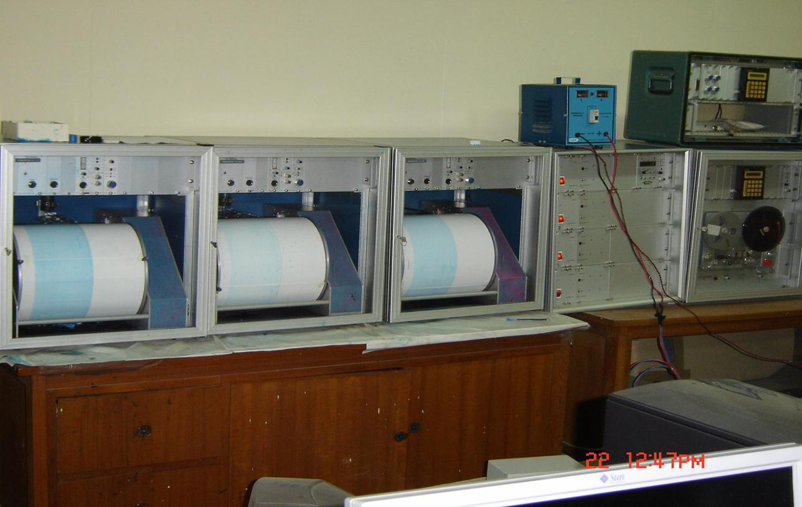
The old seismic system that have three drums , each drum represents one of the components (Z,N,E).

